Slide 1
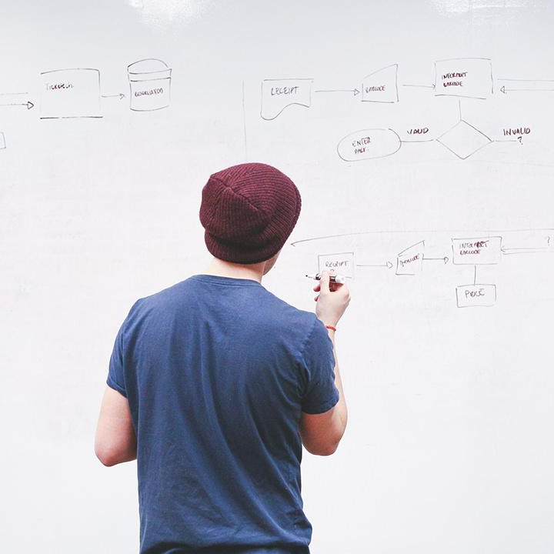
HELLO!

Slide 2
Proxy Re-Encryption for Secure Medical Data Sharing in Clouds

Slide 3
AIM OF PROJECT
The main aim of the project is to improve the current health of the community that we have shared and created .

Slide 4
ABSTRACT
In proxy re-encryption schemes, users delegate their encrypted files to other users by using re-encryption keys, which elegantly transfers the users’ burden to the cloud servers. Moreover, one can adopt conditional proxy re-encryption schemes to employ their access control policy on the files to be shared. In order to protect the files stored in the clouds, the owners can encrypt the files by using their keys before uploading the files to the clouds. Still, a user needs to be online to share her encrypted files because she needs to send her keys to her friends. It is extremely inefficient because of the heavy overhead on the user. Fortunately, proxy re-encryption schemes, enable users to share their encrypted files with other users by using re-encryption keys.

Slide 5
INTRODUCTION
In recent years, cloud computing has grown from a small concept to a rapidly growing part of IT industries. It enables numerous people to share information without geographical restrictions. Therefore, protecting sensitive files stored in the clouds from being tampered by malicious attackers is essential to the success of the cloudsCloud computing is emerging as a viable option for internet based development and services. Cloud computing is a distributed computing paradigm where the computing resources such as hardware, software, processing power are delivered as a service over a network. The cloud computing model allows the users to access information and computer resources from anywhere that a network connection is available.

Slide 6
EXISTING SYSTEM
Over time, in healthcare, electronic health records (EHR) have replaced the paper record system, so that data can be handled and maintained efficiently. It further improves the availability, sharing, and cost of data maintenance. To keep sensitive user data confidential against untrusted servers, cryptographic methods are used to provide security and access control in cloud
Risk problems become even more critical as IoT devices share sensitive data because they are directly connected to the Internet.

Slide 7
DISADVANTAGES
It is time consuming
It lacks of data security
Retrieval of data takes lot of time
Percentage of accuracy is less

Slide 8
PROPOSED SYSTEM
We have proposed a proxy re-encryption scheme for E-healthcare data sharing on fog computing, which deals with the problem of overhead and delay of previously proposed PRE schemes.Our scheme reduces the commutation cost and communication overhead of the resource-constraint IoT devices.When we need to share encrypted data with multiple participants, we can achieve significant performance by using the proxy re-encryption scheme

Slide 9
ADVANTAGES
Security against chosen ciphertext attack
It ensures the integrity of electronic health records for mobile device users stored in the cloud computing database
Fine-grain access control is provided on the user’s private data

Slide 10
ALGORITHM
AES:
AES is a symmetric type of encryption, as it uses the same key to both encrypt and decrypt data
A Key Schedule algorithm is used to calculate all the round keys from the key. So the initial key is used to create many different round keys which will be used in the corresponding round of the encryption.

Slide 11
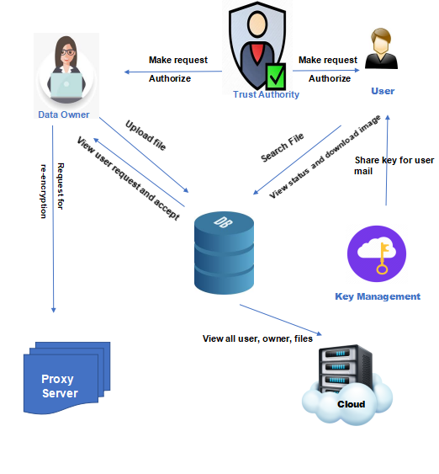
SYSTEM ARCHITECTURE

Slide 12
MODULES
In this project has six modules:
Data Owner
Data User
Proxy Server
Cloud
Trust authority
Key management

Slide 13
Data Owner:
Register the account with the basic information
After authorized by TA, login the account with the correct username and password
View Profile
Serach the medical images in the cloud
Make request to particular data owner
View the status and download the images
Logout

Slide 14
DATA USER:
Register the account with the basic information
After register user can login the account
User can enter the Diseases ,based on the all the drugs should be shown
View all recommended drugs
User can check the BMI options
Logout

Slide 15
ProxyServer
Login the account with correct credentials
View the owner re-encryption request and accept the request
Logout

Slide 16
Trust Authority
Login the account with the Correct Credentials
Authorize Owner
Authorize user
View Files
Logout

Slide 17
Key Managrment
Login the account with correct Credentials
View user request and Send Key
Logout

Slide 18
Cloud
Login the account with correct credentials
View all users
View all owners
View uploaded files
View downloaded files
Graph
Logout

Slide 19
HARDWARE REQUIREMENTS
System | Intel i3 and above
Hard Disk | 40GB
RAM | Minimum 4GB
Processor | 64-bit, four-core, 2.5 GHz minimum per core

Slide 20
SOFTWARE REQUIREMENTS
Front End Language | HTML, CSS, JAVA, JSP SERVELTS
Backend | My SQL
Operating System | Windows 10 or 11
IDE | JAVADEVELIPEMENKIT

Slide 21
FUTURE WORK
The future research may be directed towards designing a better data mining based model that can address the healthcare with real-time healthcare datasets.

Slide 22
CONCLUSION
The data mining can play a vital role in disease prediction to design a smart health prediction system. In medical diagnosis, data mining has been widely used for predicting diseases through diagnosis.
The combination of several data mining or hybrid version of data mining algorithm may be a better approach in designing health prediction system.

Slide 23

REFERENCE
[1] R. Scheffler and D. Arnold, "Projecting shortages and surpluses of doctors and nurses in theOECD,vol.14,no.2,pp.274290,2019.[Online].Available:https://scihub.tw/https://doi.org/10.1017/S174413311700055X#. [Accessed 18thNovember 2019].
[2] S. Chowdhury, "A Review Paper on Health Data Integration with Secured Record Linkage in National Health Data Warehouse and Privacy & Compatible Solution for its Privacy and Security Problems in Bangladesh and other developing countries," International Islamic University Chittagong (IIUC),2017.[Online].Availableat: https://works.bepress.com/sayem-binsarwarchowdhury/2/download/. [Accessed 18th November 2019]

Slide 24
THANKS!

